Slide 1
Intermediate Code Generation
Chapter 7

Slide 2
Outline
Intermediate code generation
Intermediate Code for Code Generation
Basic Code Generation Techniques
Code Generation of Control Statements and Logical Expressions

Slide 3
2 Basic Code Generation Techniques
Syntax-directed translation
Intermediate Code or Target Code as a Synthesized Attribute
Code generation can be viewed as an attribute computation.
Intermediate code can be generated by a post-order traversal of the syntax tree
Intermediate code can be generated during parsing

Slide 4
TAC generation for expressions/assignment statements
Attribute grammar for generating three-address code
Attribute
tacode for three-address code
name for temporary name generated for intermediate results in expressions
Symbol for string concatenation
|| is used for string concatenation with a newline
++ is used for string concatenation with a space
Function
newtemp( ) :return a new temporary name

Slide 5
TAC generation for expressions/assignment statements
Example
Given the grammar of simple expressions and assignment statements, how code can be defined as a synthesized attribute
exp -> id=exp | aexp
aexp -> aexp+factor | factor
factor -> (exp) | num | id
Tokens id and num are assumed to have a precomputed attribute strval that is the string value of the token

Slide 6
Grammar Rule | Semantic Rules
exp1 -> id=exp2 | exp1.name=exp2.name exp1.tacode=exp2.tacode|| id.strval++“=”++exp2.name / gen(id.strval“=”exp2.name)
exp -> aexp | exp.name=aexp.name exp.tacode=aexp.tacode
aexp1-> aexp2+factor | aexp1.name=newtemp() aexp1.tacode=aexp2.tacode ||factor.tacode || aexp1.name ++ ”=” ++aexp2.name ++ ”+” ++factor.name
aexp -> factor | aexp.name=factor.name aexp.tacode=factor.tacode
factor -> (exp) | factor.name=exp.name factor.tacode=exp.tacode
factor -> num | factor.name=num.strval factor.tacode=“ ”
factor -> id | factor.name=id.strval factor.tacode=“ ”

Slide 7
tacode attribute of expression “(x=x+3)+4”
exp
name=t2;tacode=“t1=x+3 x=t1
t2 = t1+4”
aexp
name=t1;
tacode=“t1=x+3
x=t1”
aexp + factor
name=4
factor
num (4)
( exp )
name=t1;tacode=“t1=x+3
x=t1”
id = exp
name=t1;tacode=“t1=x+3”
(x)
aexp
name=t1;tacode=“t1=x+3”
name=x
aexp + factor
name=3
name=x
factor
num (3)
id (x)

Slide 8
Code generation for individual language constructs
A program consists of declarations and statements
Declarations do not generate intermediate codes, for each declared name, we create a symbol-table entry
Basic code generation for assignment and simple arithmetic expressions including Array reference (2.)
Code generation for control statements and boolean expressions (3.)

Slide 9
TAC generation for declarations
Declarations do not generate intermediate codes, for each declared name, we create a symbol-table entry
Grammar rule | Semantic Rules
decl→type varlist | varlist.type=type.type
type→int | type.type=integer
type→float | type.type=real
varlist1→id,varlist2 | insert(id.name,varlist1.type) varlist2.type =varlist1.type
varlist→id | insert(id.name,varlist.type)

Slide 10
TAC generation for Array reference in expressions/assignment
Array elements can be accessed quickly if they are stored in a block of consecutive locations.
The chief problem in generating code for array references is to relate the address-calculation
Address-calculation
Based on the relative address (base) of the storage allocated for the array, layout for the array, and the width of array elements

Slide 11
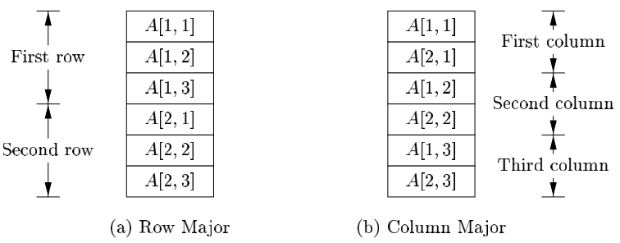
TAC generation for Array reference in expressions/assignment
Layout for the array
row-major (row-by-row) vs. column-major (column-by-column)

Slide 12
TAC generation for Array reference in expressions/assignment
TAC generation for Array reference
If base is the relative address of the storage allocated for the array, and the width of each array element is w with row-major layout, the address-calculation for array reference can be
The element of A[i] begins in location base + i * w
The element of A[i][j] in A[n][m] may begin in location base + (i*m+j)*w

Slide 13
Attribute Grammar of TAC generation for Array reference in expressions
Grammar Rule | Semantic Rules
E → E¹+E² | E.name=newtemp(); E.tacode=E¹.tacode ||E².tacode || gen(E.name “=” E¹.name “+” E².name)
E → id | E.name= id.name E.tacode=“ ”
E → L | E.name = newtemp(); E.tacode=L.tacode ||gen(E.name “=” L.array.base[L.offset])
L → id[E] | L.array = lookup(id.name); L.type = L.array.type.elem; L.offset = newtemp(); L.tacode=E.tacode||gen(L.offset“=”E.name“*”L.type.width)
L → L¹[E] | L.array = L¹.array; L.type = L¹.type.elem; t = newTemp(); L.offset = newtemp (); L.tacode=L¹.tacode ||E.tacode ||gen(t “=” E.name“*”L.type.width) ||gen(L.offset “=” L¹.offset “+” t);

Slide 14
TAC generation for Array reference in expressions
Example: c + a[i][j], let c, i, j all denote integer variables, a denote a 2*3 array of integers
name=t5;tacode=“t1=i*12
t2=j*4
t3=t1+t2
t4=a[t3]
t5=c+t4”
E
name=t4;tacode=“t1=i*12
t2=j*4
t3=t1+t2
t4=a[t3]”
name=c;
tacode=“”
E2
E1 +
array=(base=a,
type=array(2, array(3,integer)) );
type=integer; offset=t3;
tacode=“t1=i*12
t2=j*4
t3=t1+t2”
id (c)
array=(base=a,
type=array(2, array(3,integer)) );
type=array(3,integer); offset=t1;
tacode=“t1=i*12”
L
L¹
[ E ]
name=i;
tacode=“”
name=i;
tacode=“”
id (j)
id (a) [ E ]
id (i)

